Slide 1
LINE Messaging API Integration with Java Spring Boot
Md. Badrul Alam
hridoyjbd@gmail.com
+8801712680010 (WhatsApp)

Slide 2
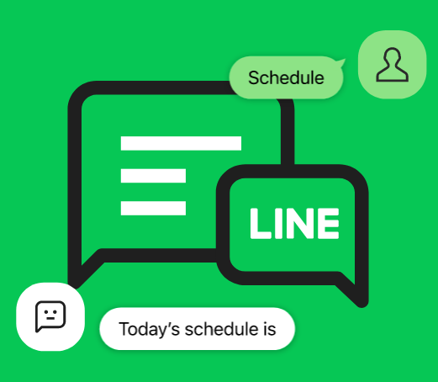



LINE Messaging API
Messaging API
Get engaged in interactive conversations with LINE users.
What is the Messaging API?
The Messaging API lets you develop two-way communication between your service and LINE users.

Slide 3
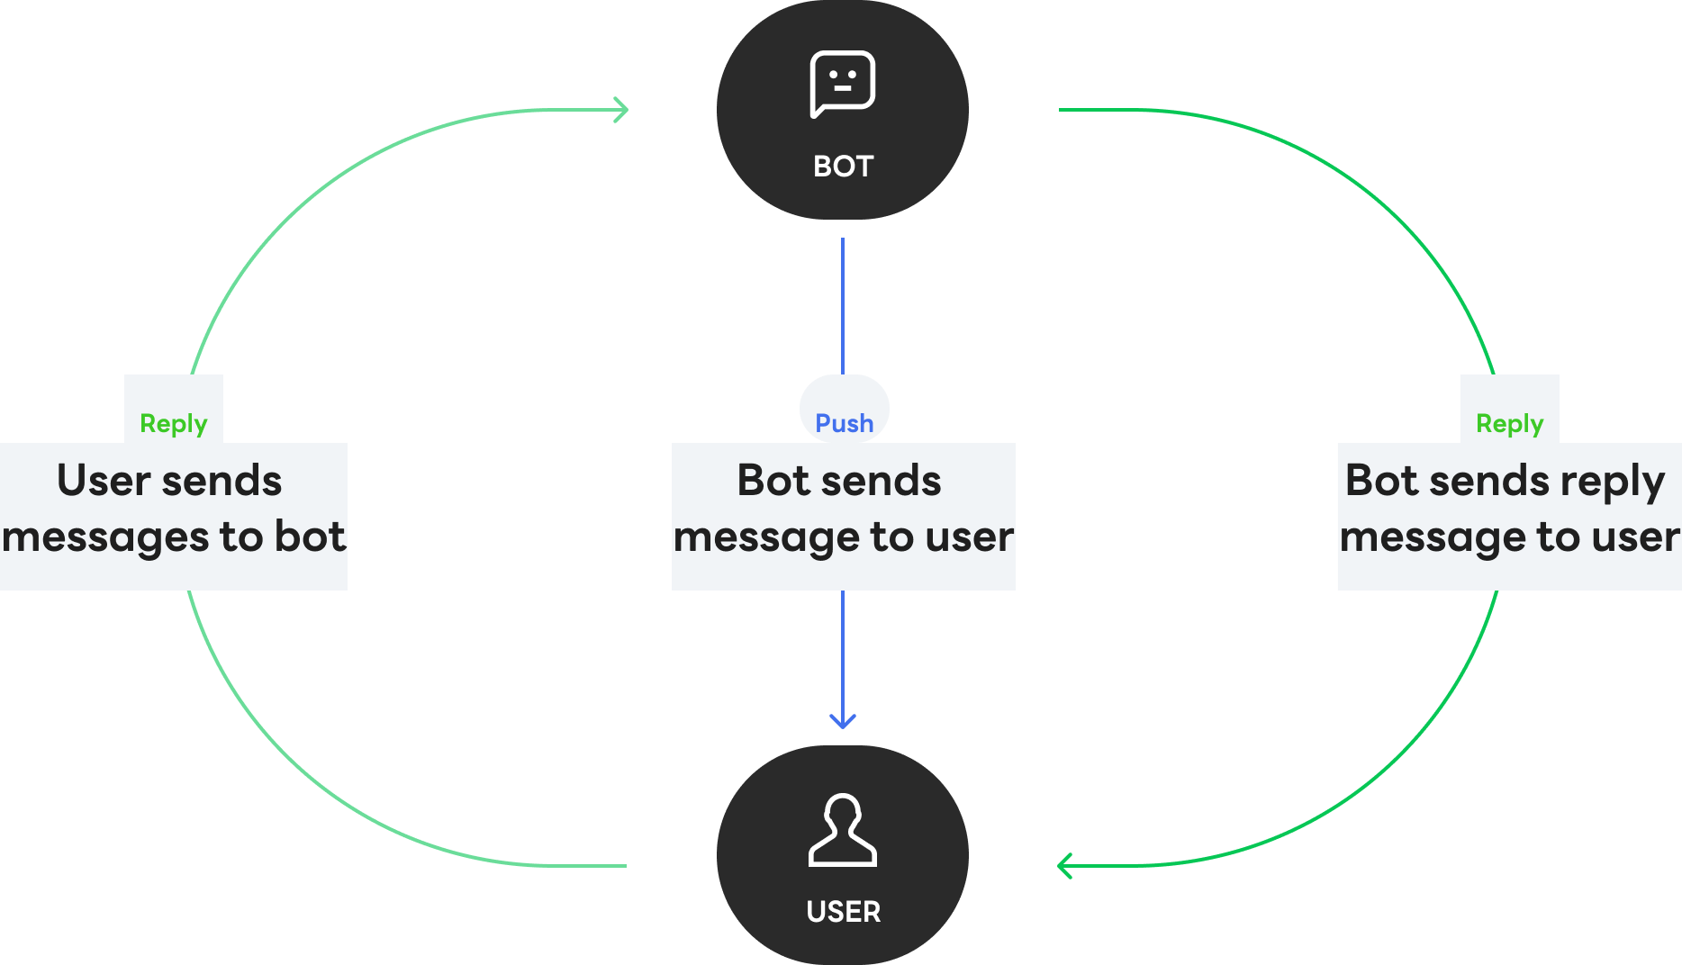
LINE Sending messages
Your bot can send messages to users at any time.
Your bot can also reply in response to users' messages with reply messages.

Slide 4
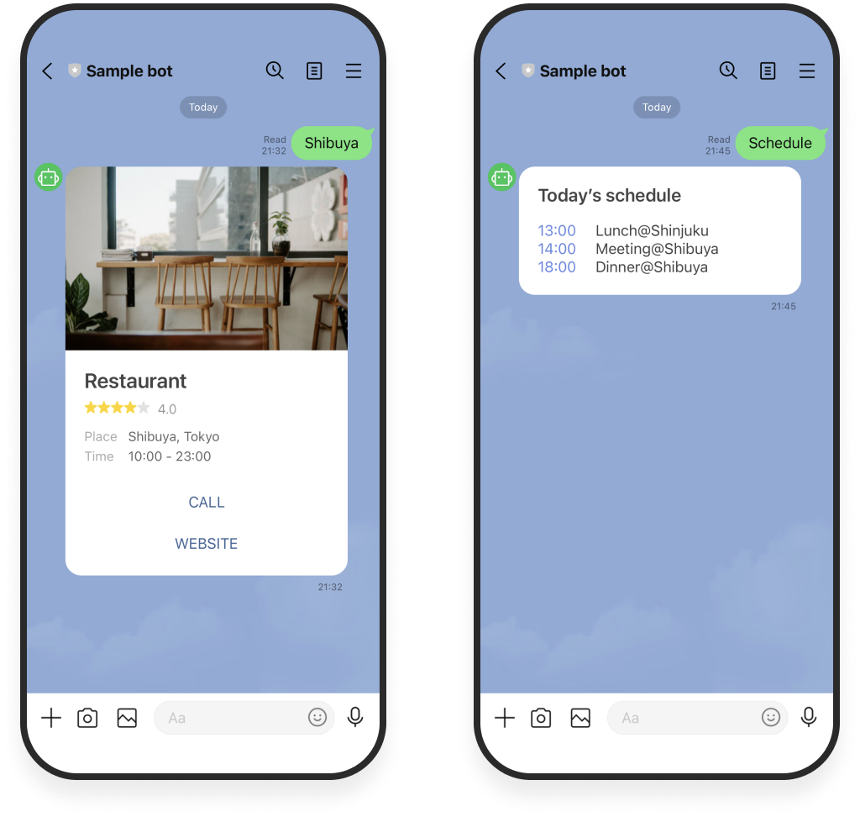
LINE 1-on-1 and group chats
Send messages not only to users who have added your bot as a friend but also, in group chats that your bot has been added to.

Slide 5
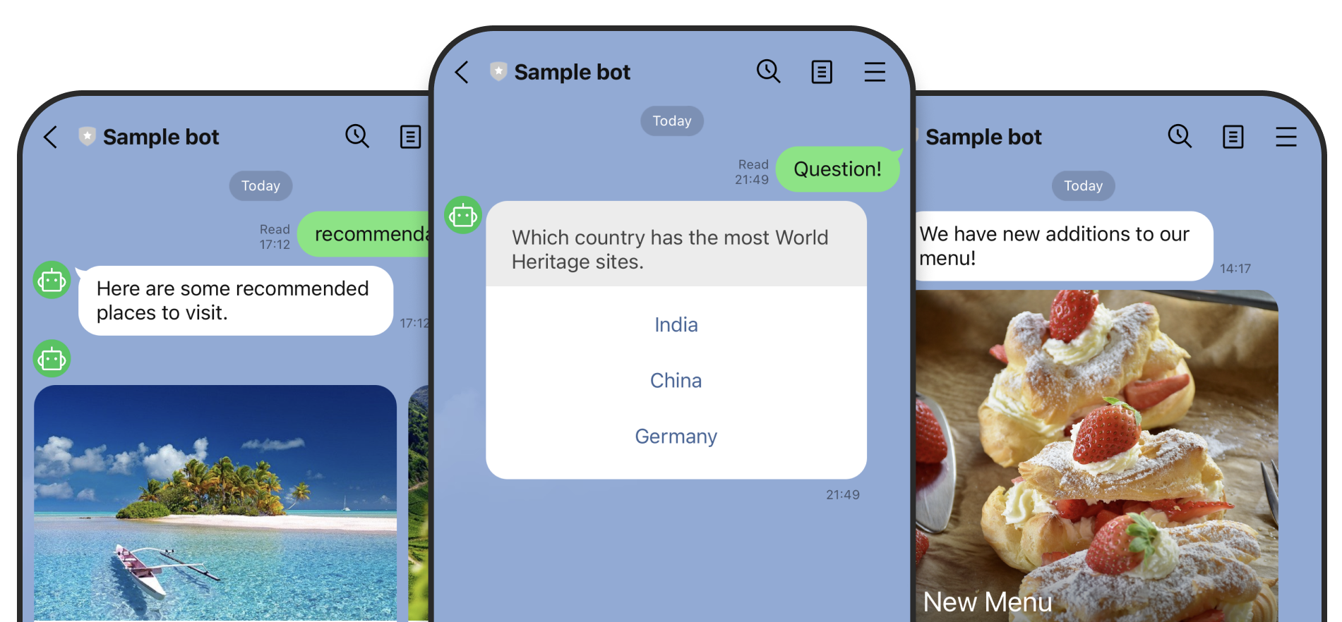
LINE The perfect message type for every occasion
Choose the right message type to effectively engage and connect with your users.

Slide 6
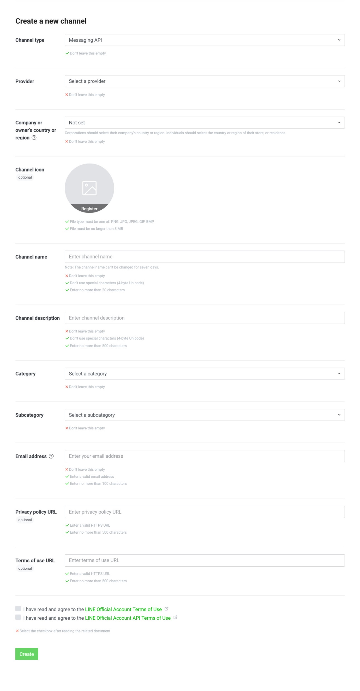

LINE Create new Channel

Slide 7
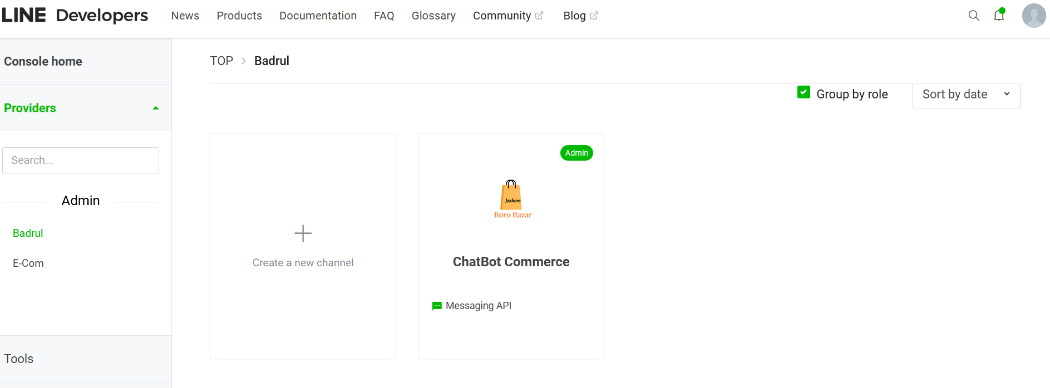
LINE Channel List

Slide 8
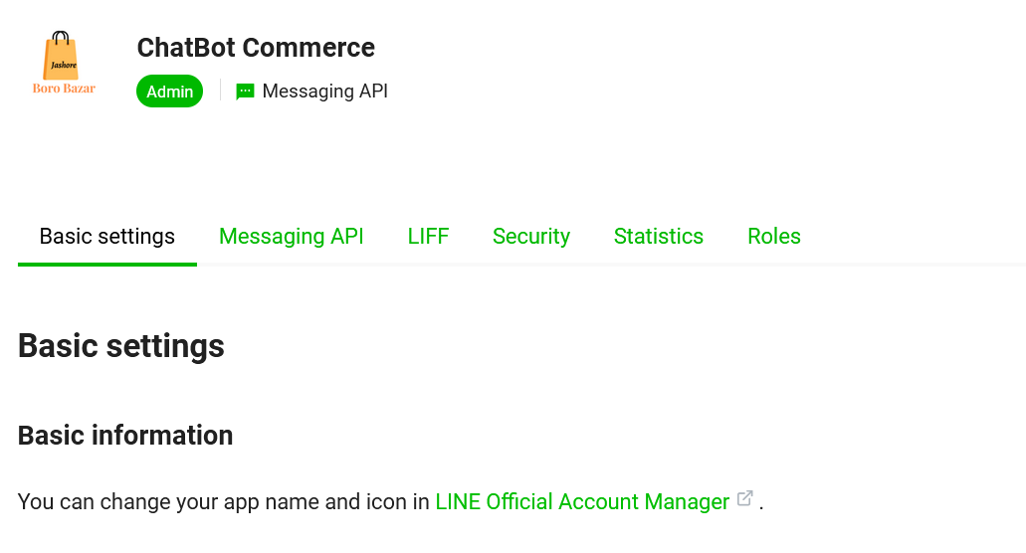
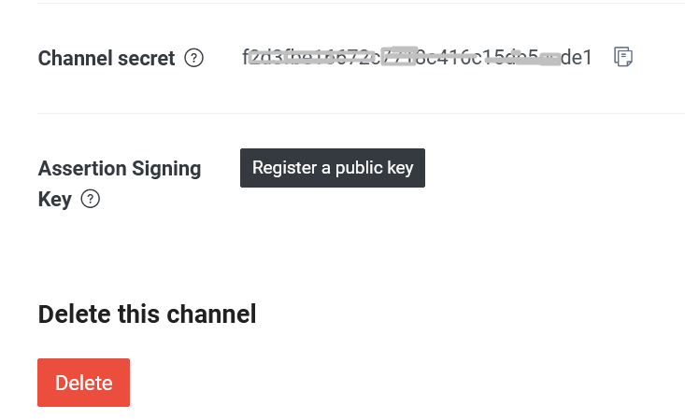
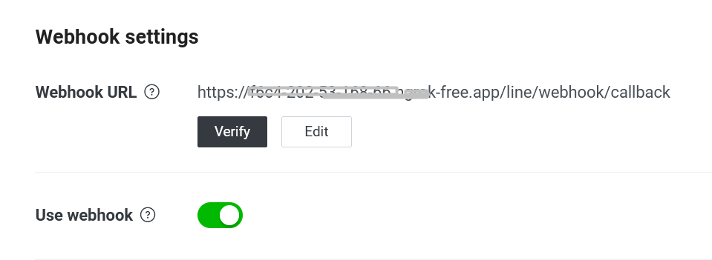
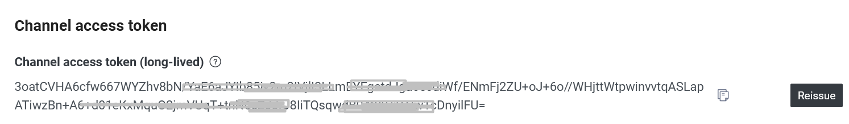
LINE Channel Settings

Slide 9
Thank you

